Slide 1
UNIT 1: Reproducible Research

Slide 2
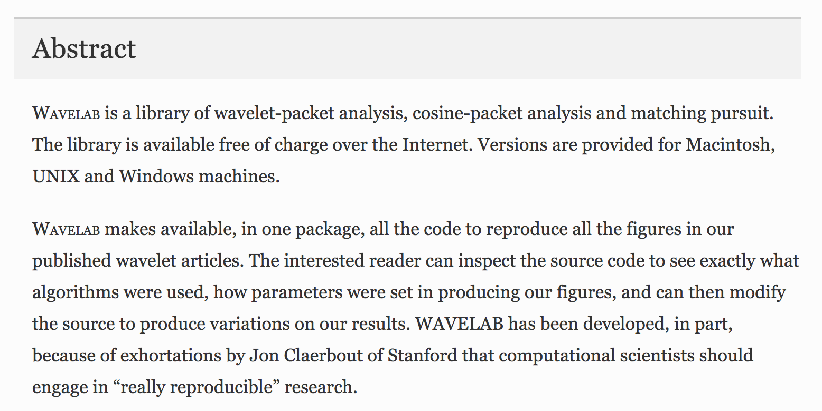
Example of Reproducible Charts and Calculation: WAVELAB
https://link.springer.com/chapter/10.1007%2F978-1-4612-2544-7_5

Slide 3
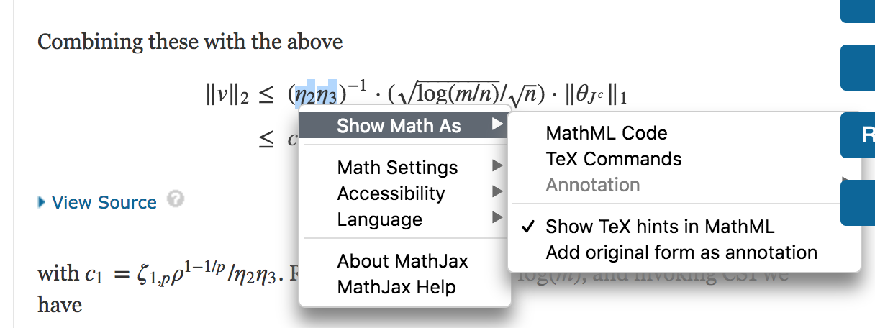
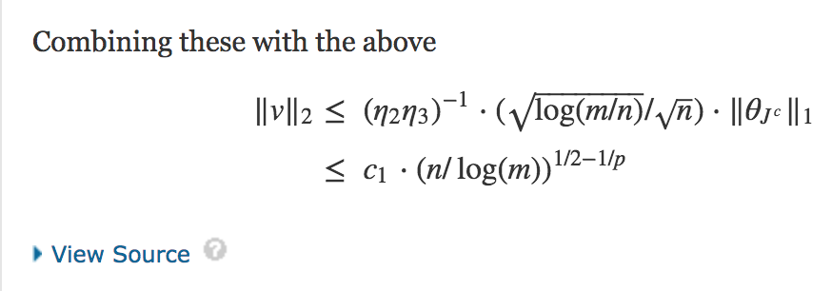
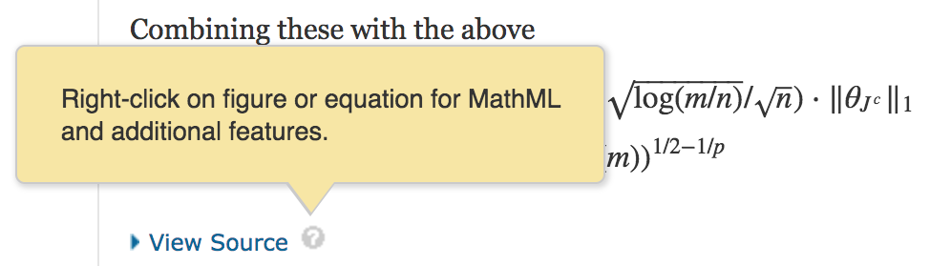
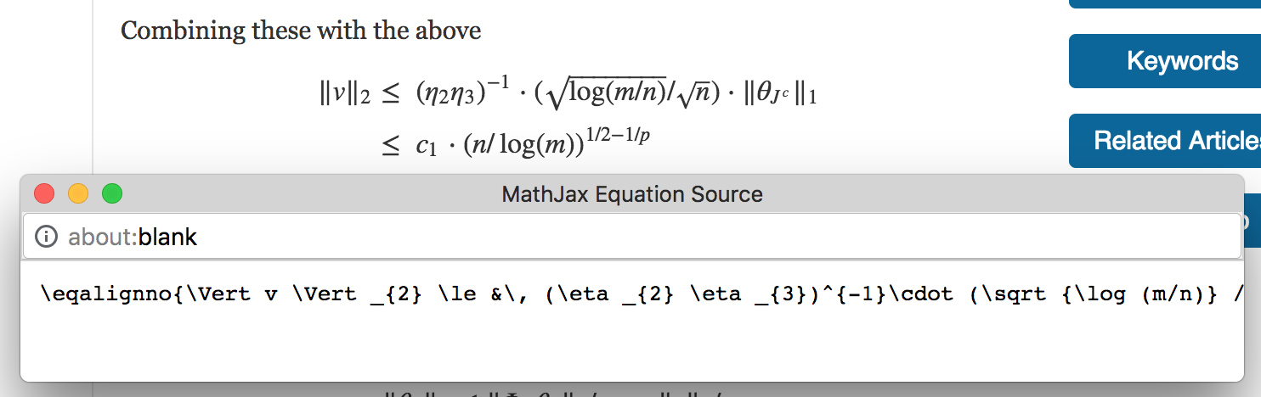
Example of Reproducible Formula Code

Slide 4
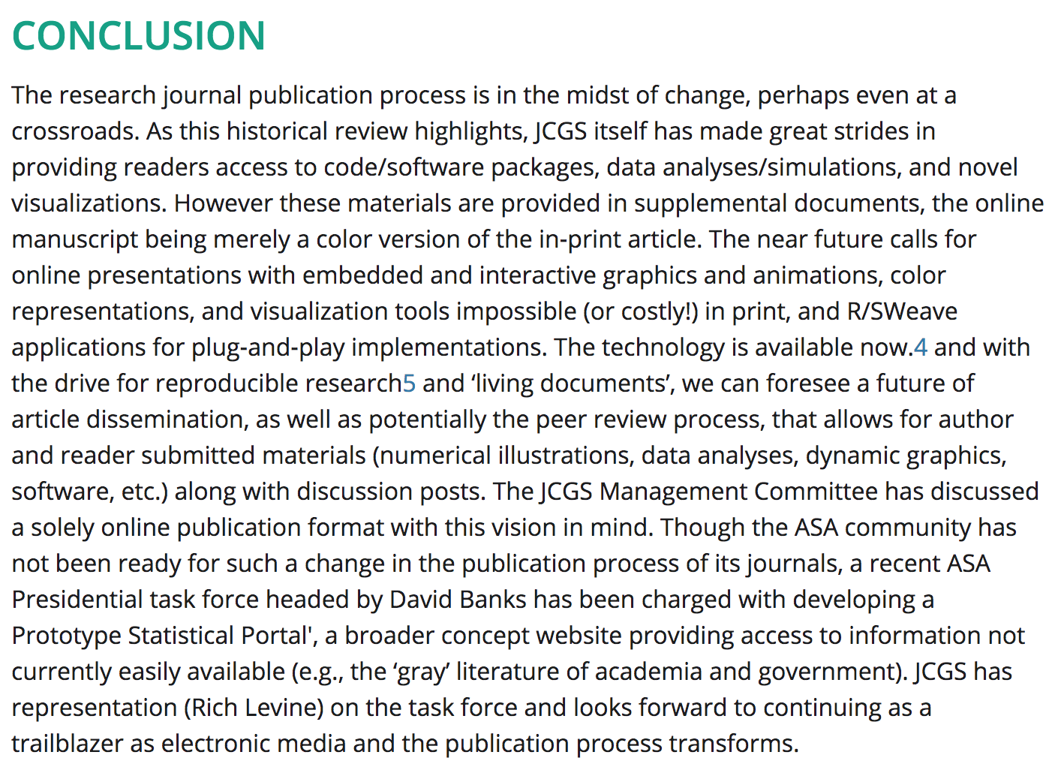

Slide 5
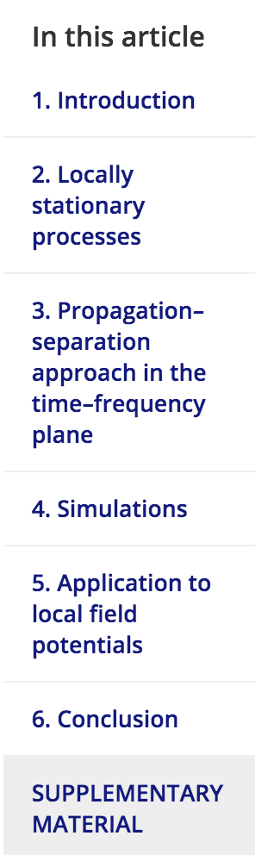

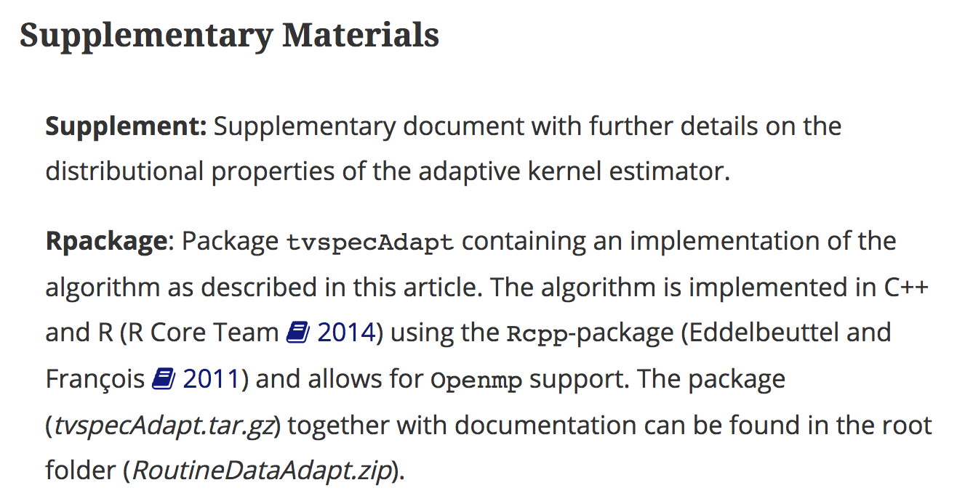
https://www.tandfonline.com/doi/pdf/10.1080/10618600.2018.1512866?needAccess=true

Slide 6
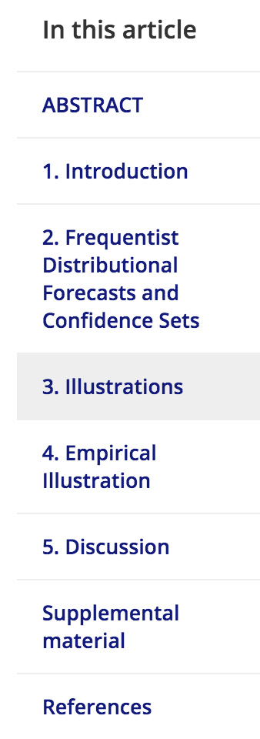

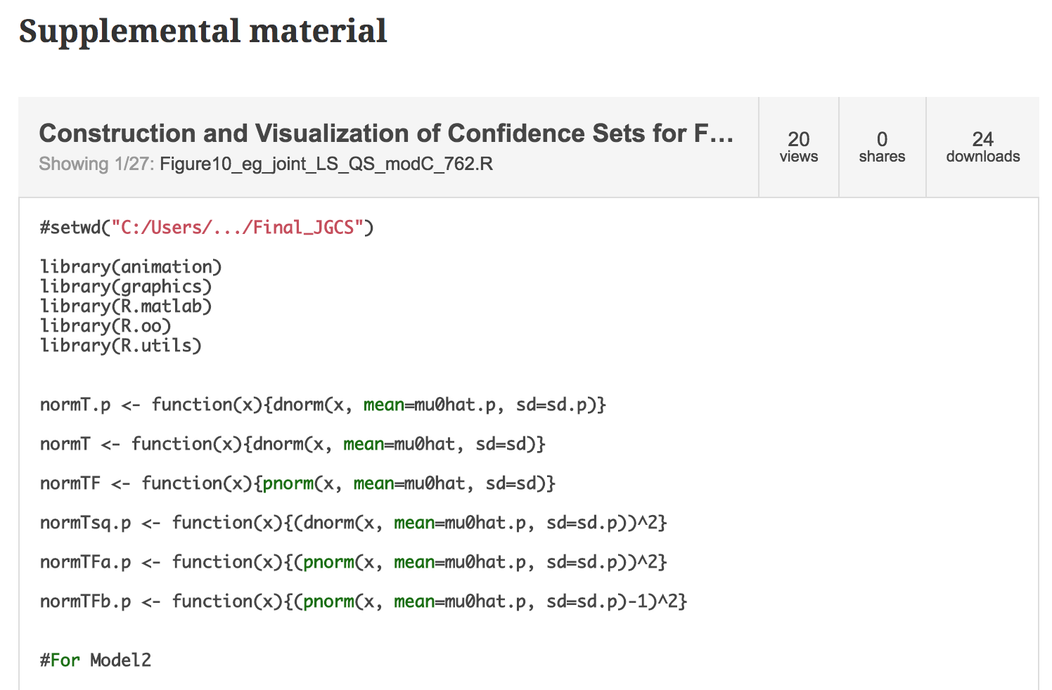
https://www.tandfonline.com/doi/full/10.1080/10618600.2018.1476252

Slide 7
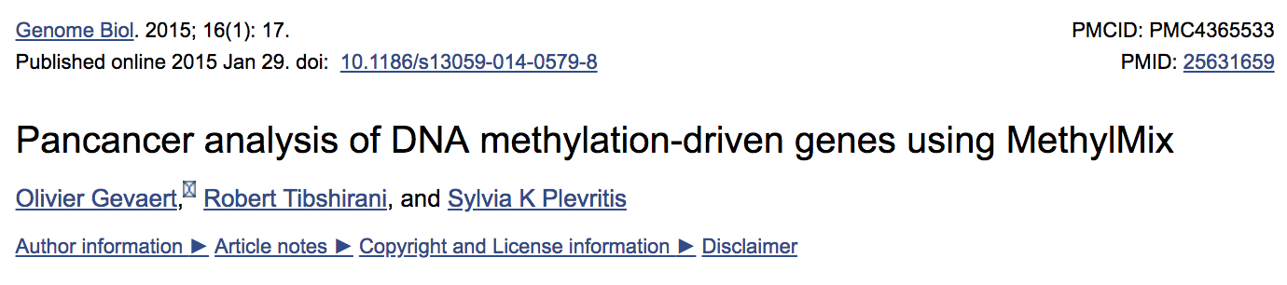
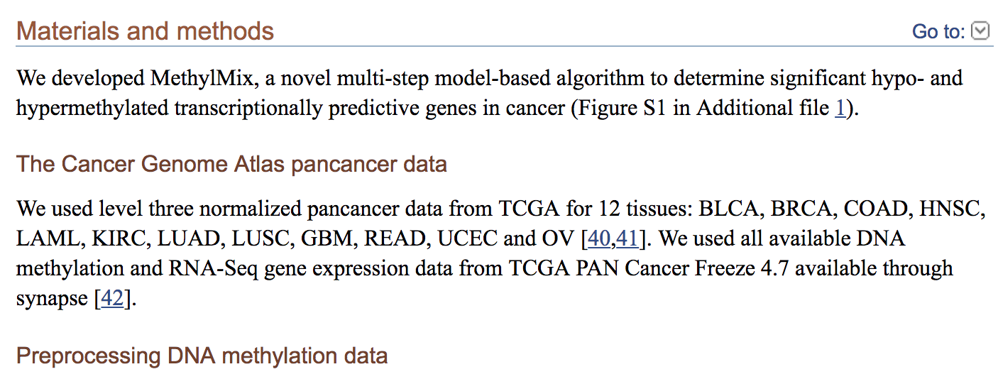
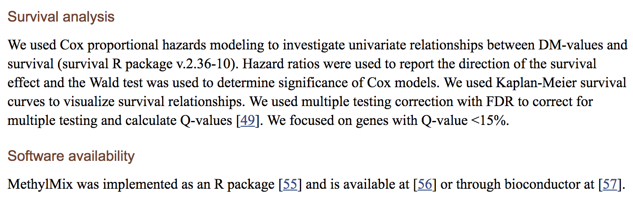
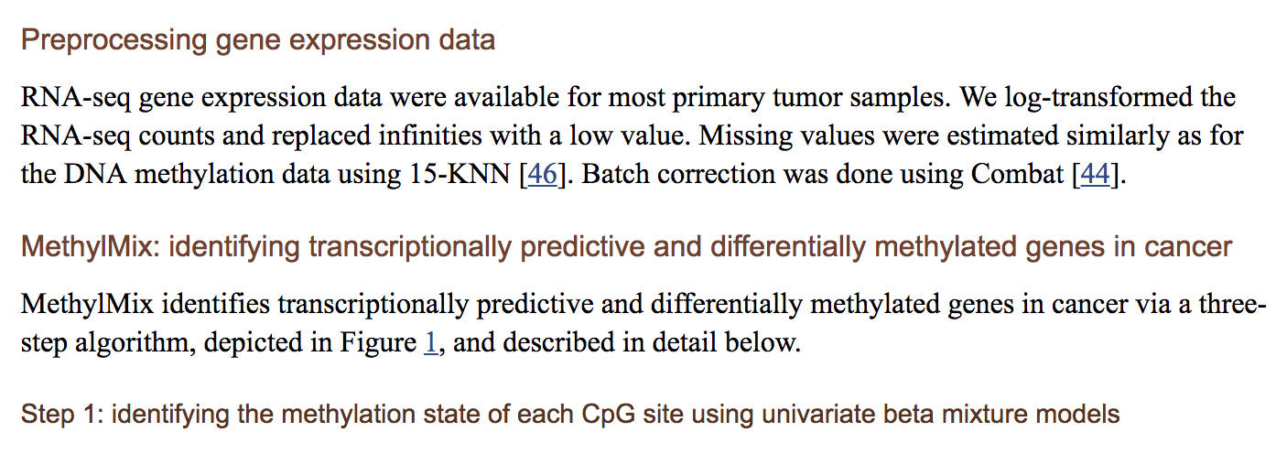
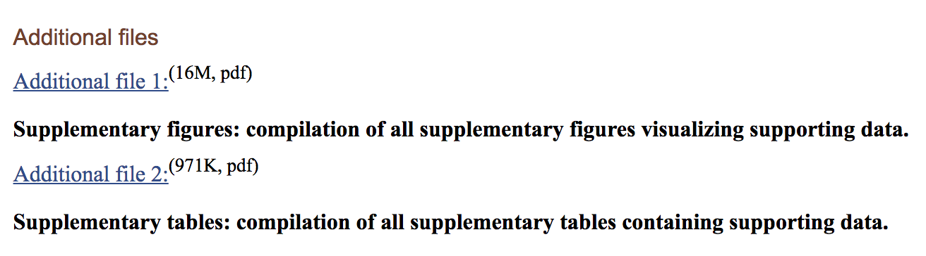
Another Example: Robert Tibsherani
https://www.ncbi.nlm.nih.gov/pmc/articles/PMC4365533/

Slide 8
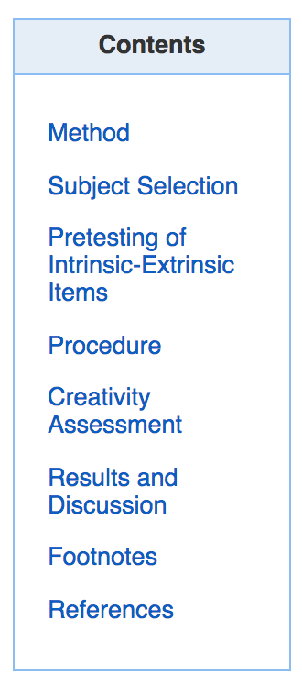

Non-Reproducible: Creativity Study (Statistical Sleuth)
http://web.b.ebscohost.com.proxy.libraries.smu.edu/ehost/detail/detail?vid=0&sid=800b52fe-0c97-428c-bff5-fd5d7a497738%40pdc-v-sessmgr04&bdata=JnNpdGU9ZWhvc3QtbGl2ZSZzY29wZT1zaXRl#AN=1985-19751-001&db=pdh
http://web.b.ebscohost.com.proxy.libraries.smu.edu/ehost/detail/detail?vid=0&sid=66a4a398-ae72-48f1-b9fd-43a91350445d%40pdc-v-sessmgr02&bdata=JnNpdGU9ZWhvc3QtbGl2ZSZzY29wZT1zaXRl#AN=1985-19751-001&db=pdh

Slide 9
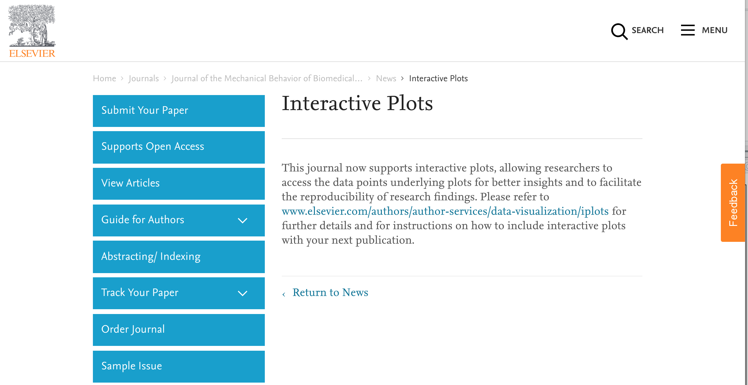
https://www.journals.elsevier.com/journal-of-the-mechanical-behavior-of-biomedical-materials/news/interactive-plots

Slide 10
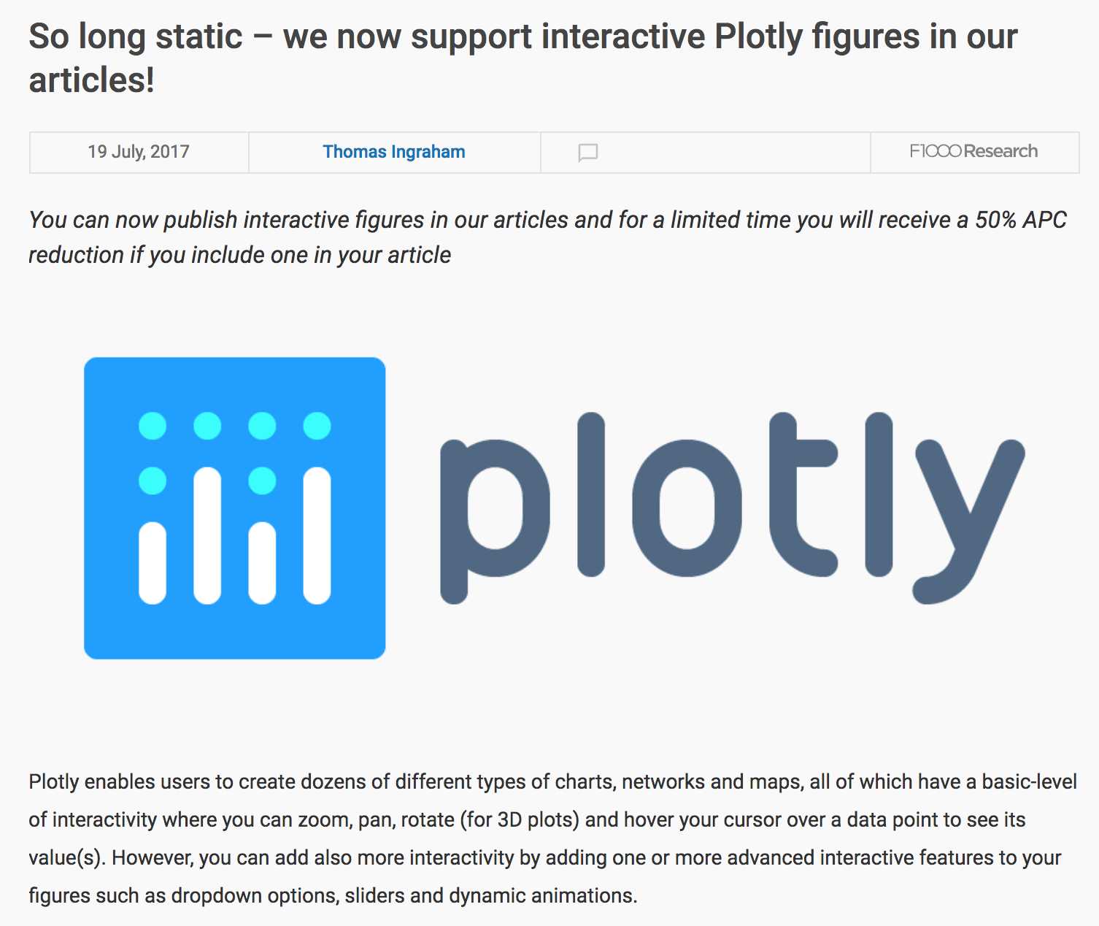
https://plot.ly/r/knitr/
https://blog.f1000.com/2017/07/19/so-long-static-we-now-support-interactive-ploty-figures-in-our-articles/

Slide 11

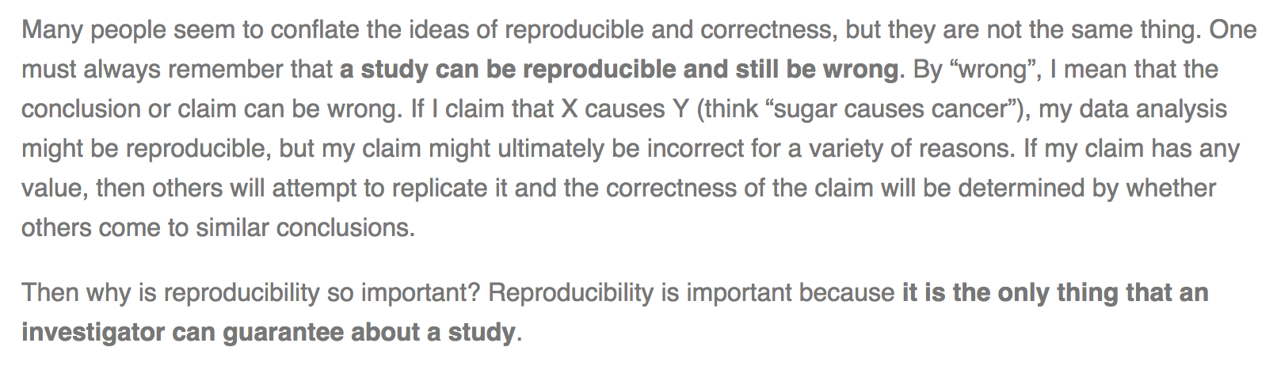
Final Thought
https://simplystatistics.org/2014/06/06/the-real-reason-reproducible-research-is-important/

